Slide 1

Loan Design
IT
Written by Meghan
2022.05.14

Slide 2

Contents
1. Flow
2. Design prototype
3. Exception

Slide 3
1. Flow
1) GME Main page
2) Click [Loan] button
3) Loan main page
4) Click [Check My loan] button
5) Enter ID Number
6) Loan List
7) Loan Detail history

Slide 4
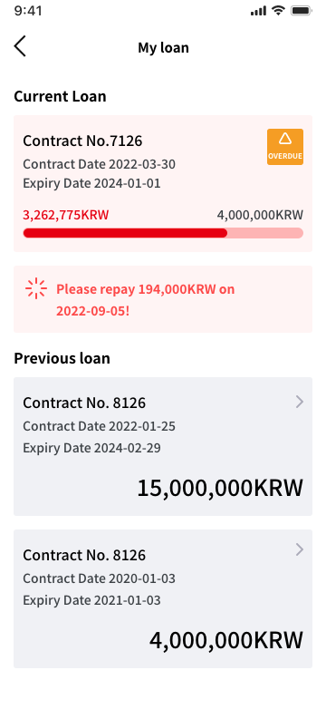
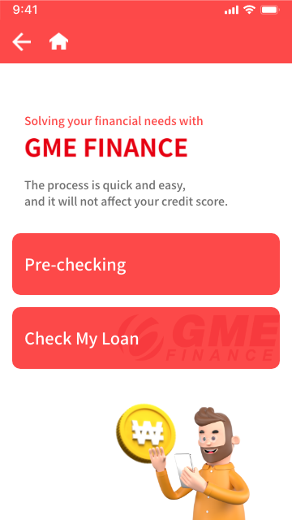
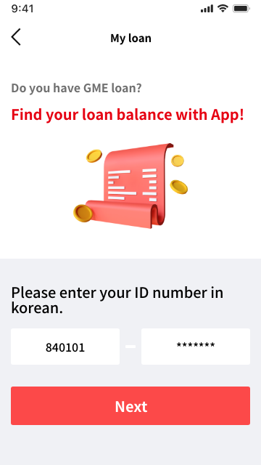
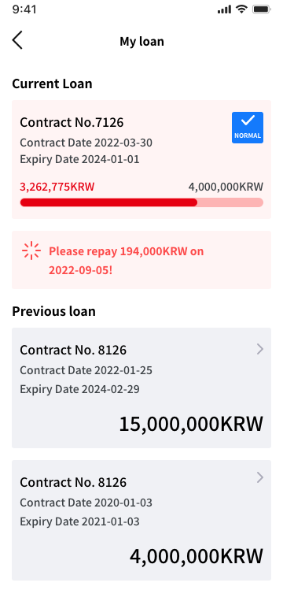
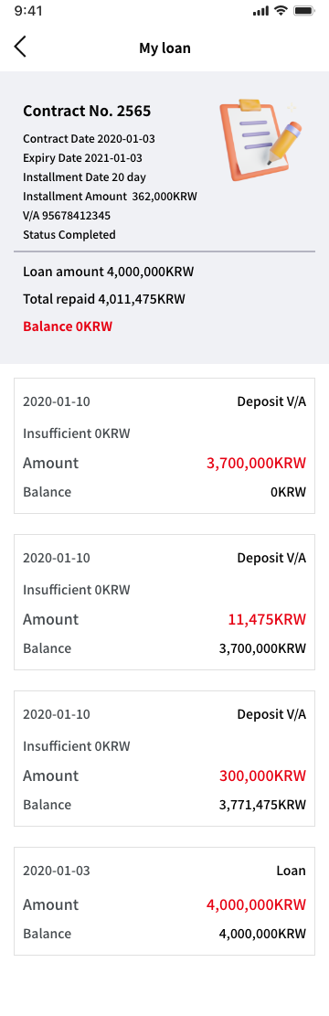
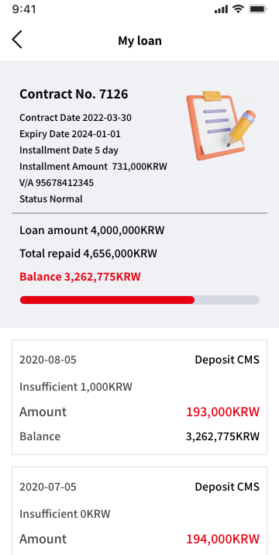
2. Design prototype
Design-English
-English https://xd.adobe.com/view/0e306468-d196-494b-a906-297ecd98e9b8-5b63/
Previous loan
Current loan

Slide 5
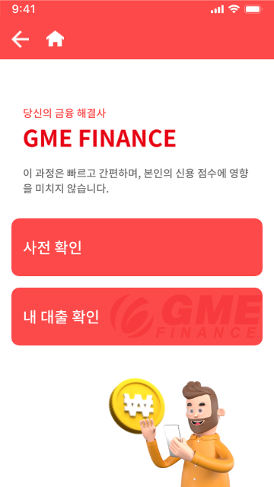
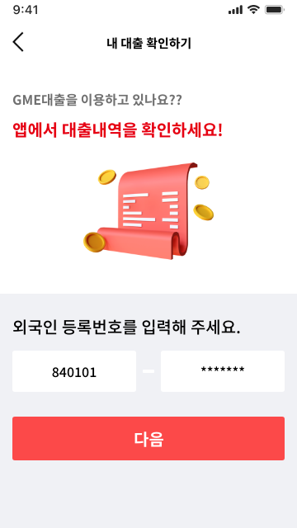
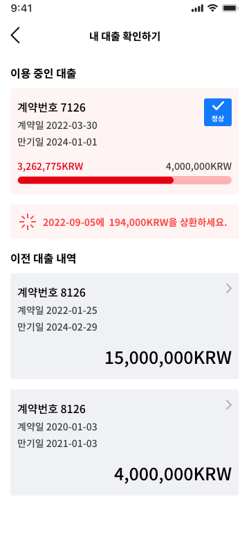
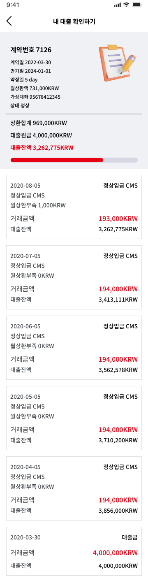
2. Design prototype
Design-Korean
-Korean https://xd.adobe.com/view/d01a5ae6-d90b-40f4-86b7-067e5a3d6935-8549/
Previous loan
Current loan

Slide 6
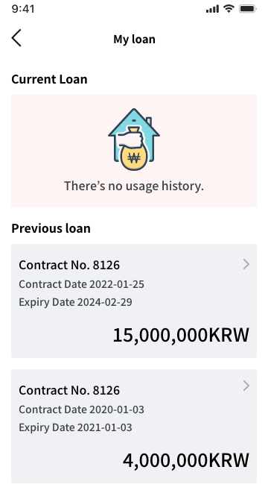
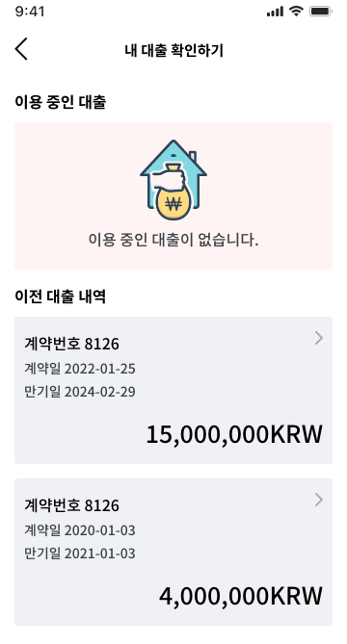
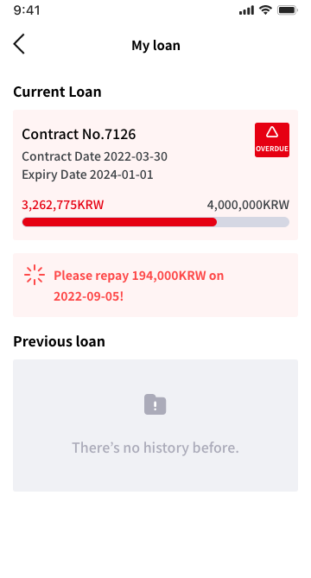
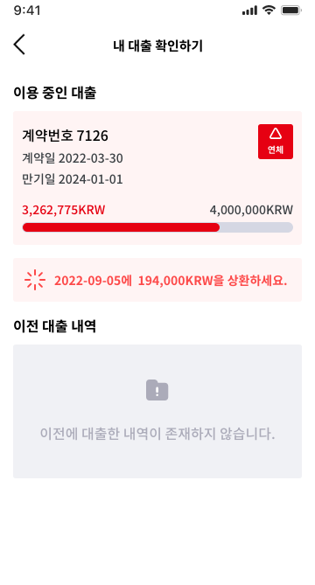
3. Exception
no usage history
no history before.

Slide 7


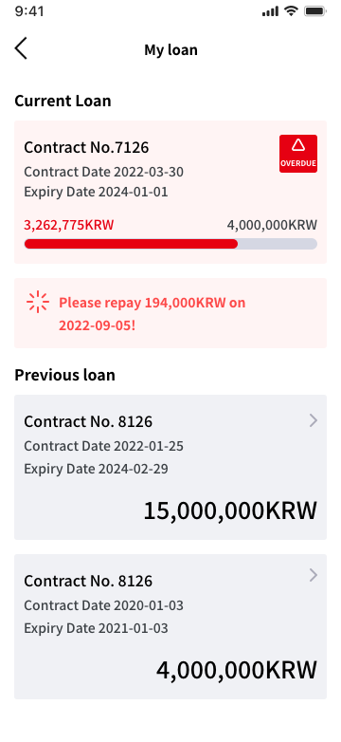


3. Exception
Normal
Overdue

Slide 8
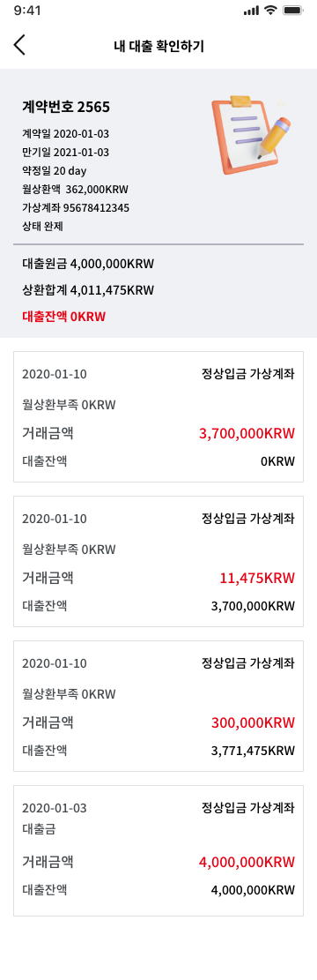
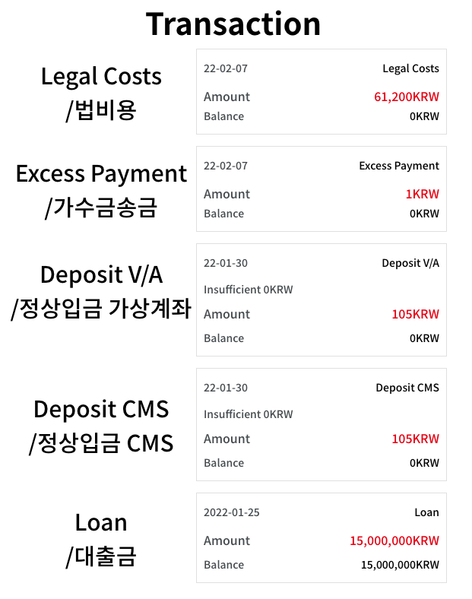
3. Exception

Slide 9
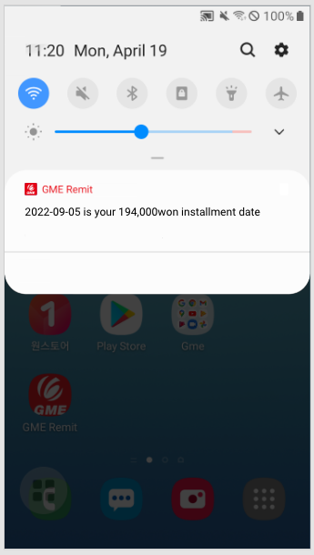
3. Exception
약정일 전날 밤 12시가 넘어가면 push 보내기
예) 약정일 9월 5일 이면 9월 4일 AM 09:00:00에 Push 메세지를 보냄

